Slide 1
Zusammenfassung Master Thesis

Slide 2
Gliederung
Introduction
Initial Situation & Problem
Objective & Research Questions
Methodology Overview
Theoretical Foundation
Discrete Material Flow Systems & SBDTs
Process Mining & Event Logs (OCEL)
VVUQ Concepts & Challenges
ML-Based Approaches for VVUQ
Methodology
Automated VVUQ Framework Design
Permutation Testing for Significance
Implementation
Architecture & Setup (OCEL Format)
Model Implementation (Whitebox & Blackbox: ResNet-BiLSTM)
Empirical Validation
Case Study: IoT Factory & OFacT SBDT
Validation Setup & Results
Discussion
Comparison to Traditional Methods
Context of Research Questions
Implications & Limitations
Conclusion & Future Work

Slide 3
Challenge
Digital Twins (DTs) are key for Industry 4.0, enabling monitoring and optimization.
Simulation-Based DTs (SBDTs) are crucial for complex systems like Discrete Material Flow Systems (DMFS).
Trend towards automatically generating SBDTs from data to reduce effort.
The Challenge: How can we ensure these automatically generated SBDTs are accurate and trustworthy? Manual validation undermines the automation benefits.

Slide 4
Problem Statement & Objective
Problem: Manual Verification, Validation, and Uncertainty Quantification (VVUQ) of automatically generated SBDTs is inefficient, costly, and hinders scalability. Lack of standardized methods creates a trust deficit.
Objective: Develop and evaluate a data-driven framework for automated VVUQ of automatically generated SBDTs, focusing on DMFS.
Research Questions: RQ1: Efficient implementation of automated VVUQ?
RQ2: Best data-driven approaches for discrepancy detection?
RQ3: Improvement over traditional methods?

Slide 5
Traditional VVUQ is bad!
Manual Effort: Highly labor-intensive, requires domain experts.
Scalability Issues: Difficult to apply continuously or frequently, especially with evolving SBDTs.
Subjectivity: Expert reviews can be subjective.
Inefficiency: Undermines the cost/time benefits promised by automated SBDT generation.

Slide 6
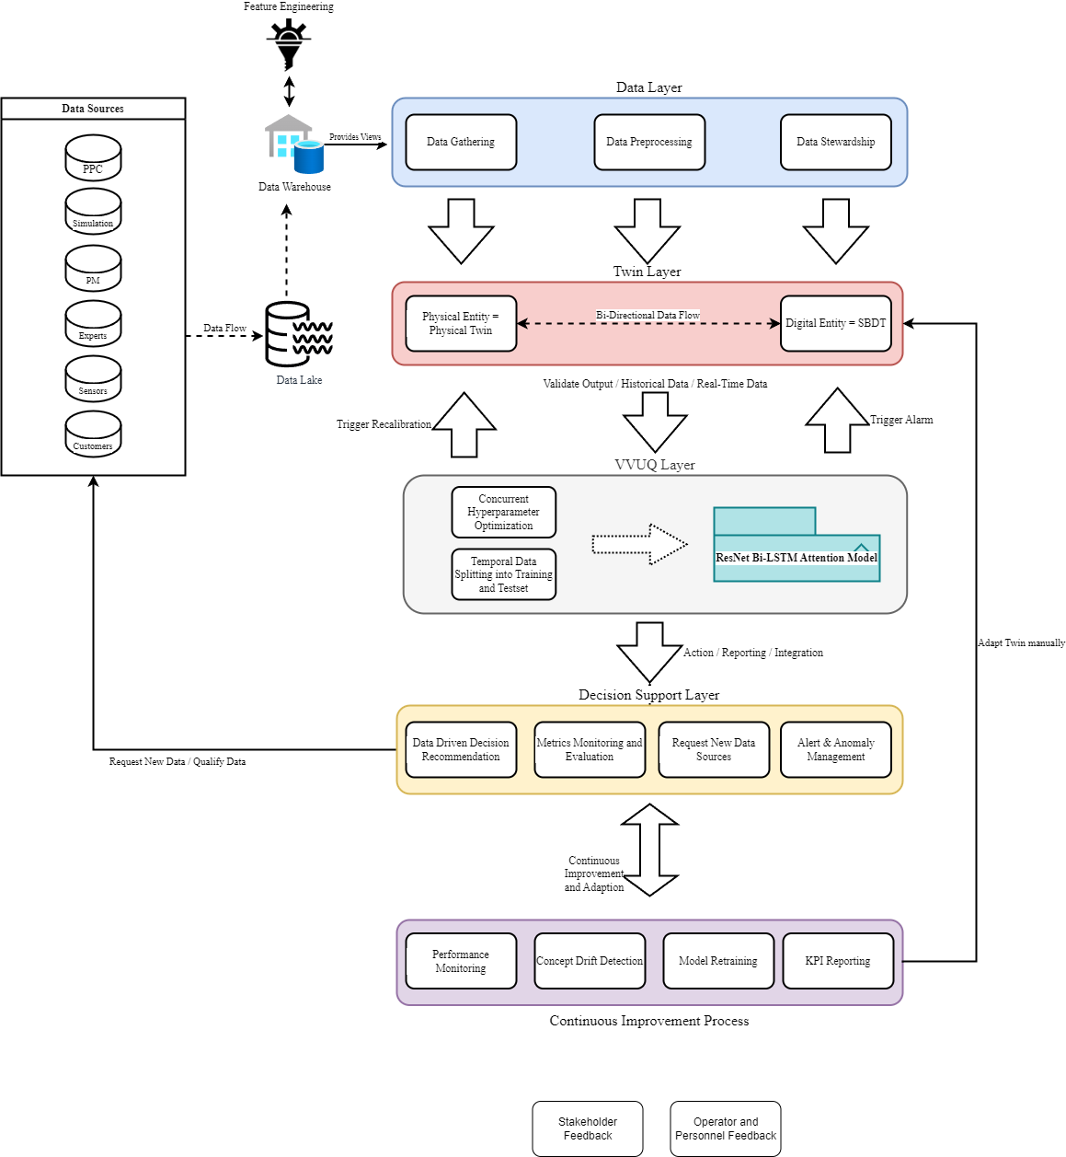
Automated Framework

Slide 7
ML-based!
Idea: Treat validation as a supervised classification problem (not as unsupervised see Dos Santos 2024)
Input Data: Process execution data from Real System and Simulated SBDT, formatted as Object-Centric Event Logs (OCEL).
Labels: Assign different labels (e.g., Real = 1, Simulated = 0).
Classifier: Train an ML model (e.g., BiLSTM) to distinguish between the two data sources based on feature subsets representing SBDT components (time, resources, process flow etc.).

Slide 8
The Reversed Interpretation: Performance NOT-EQ Fidelity
Traditional ML Goal: High accuracy/AUC = Good model performance.
Our Validation Goal: Assess SBDT fidelity.
The Key Insight:
IF Classifier performs POORLY (AUC ≈ 0.5): It cannot distinguish real vs. simulated data. => HIGH SBDT Fidelity (The twin successfully mimics reality for those features).
IF Classifier performs WELL (AUC >> 0.5): It can easily distinguish real vs. simulated data. => LOW SBDT Fidelity (The twin failed to replicate real-world complexity/patterns).
High classifier performance signals detectable discrepancies in the SBDT component being tested.

Slide 9
Multi Ensemble Approach!
Models Used:
Whitebox Baseline: Decision Tree (DTree) - Interpretable.
Blackbox: ResNet-BiLSTM-Attention - Captures sequential patterns.
Statistical Significance: How confident are we that the classifier isn't just guessing?
Permutation Testing:
Shuffle labels randomly many times (simulating "no difference").
Calculate classifier performance (AUC) on shuffled data to get a "null distribution".
Compare observed AUC to null distribution => p-value.
Low p-value (< α): Observed AUC is unlikely due to chance => Statistically Significant Difference Found.
Repeat multiple runs => Rejection Rate (RR): How consistently is the difference found?
Applied on IoT Factory Data!

Slide 10
Put Features into Feature Subsets = Model Components in Framework Schwede & Fischer 2024
Time Model:
Features: duration, start_time, end_time, and other engineered time features (e.g., cyclical encodings).
Transition Model:
Features: process_id, resource_id, end_time.
Transformation Model:
Features: part_id.
Quality Model:
Note: Quality information excluded in the current validation model.
Resource Model:
Features: resource_id, process_id, part_id.
Resource Capacity Model:
Features: resource_id.
Note: Insufficient data available for detailed capacity modelling in this study.
Process Model:
Features: process_id, part_id, resource_id.

Slide 11
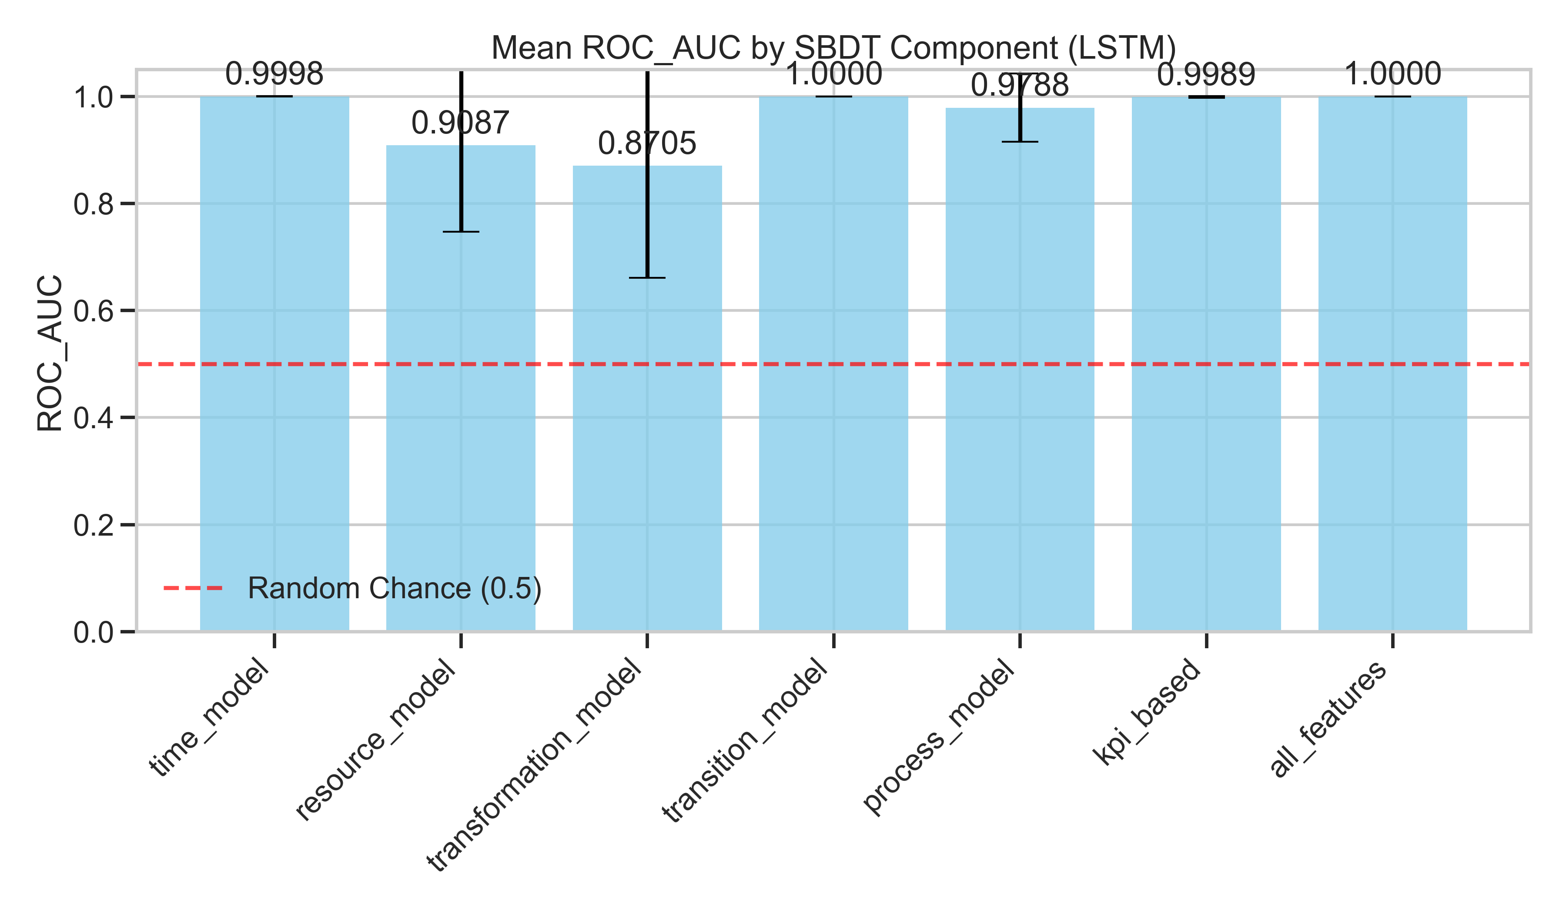
Key Result: Detecting Discrepancies
Permutation Test Results (BiLSTM, α=0.01)
High Mean ROC AUC scores observed for most SBDT components (e.g., Time: 0.9998, Transition: 1.0000, Process: 0.9788).
Very Low Mean p-values (often ≈ 0.0000).
High Rejection Rates (RR ≥ 0.80 for all components, often 1.00).
Similar significant results found with the Whitebox (DTree) model.

Slide 12
Interpretation: Framework Successfully Identifies Inaccuracies
Both ML models consistently and statistically significantly distinguished between real and simulated data across all tested SBDT components.
Conclusion (Based on Reversed Interpretation): The current configuration of the OFacT SBDT exhibited detectable inaccuracies compared to the real IoT Factory data for aspects like time model, resource usage, process flow etc.
Value: The framework worked as intended – it successfully shows where the SBDT's fidelity was lacking, providing targeted feedback for improvement.

Slide 13
OCEL Data Structure (wie besprochen)
Column Name | Data Type | Description
process_execution_id | int | Unique identifier for the specific process recorded.
order_id | Index (int/str) | Identifier for the overall manufacturing order.
start_time | Timestamp [UTC] | Precise start timestamp of the event (UTC).
end_time | Timestamp [UTC] | Precise end timestamp of the event (UTC).
duration | float (seconds) | Calculated event duration (end_time - start_time) in seconds.
part_id | int | Identifier for the specific part/component being processed.
resource_id | int | Identifier for the machine, station, or resource involved.
process_id | int | Identifier indicating the type of process step or operation.
type | str | Textual description or category classifying the event type.
is_valid | bool | Boolean flag indicating if the event/sequence is considered valid.

Slide 14
Alle engineered Features (wie besprochen)
Key Performance Indicators (KPIs)
Added for VVUQ (Verification, Validation, Uncertainty Quantification):
Throughput
Setup Time
Lead Time
Cycle Time
Purpose:
Assist PPC (Production Planning & Control) VVUQ (Ref: Subsection 2.1.4).
Enable integration to validate Time Model learning.
Additional Features for Analysis
duration:
Length of the process step (End Time - Start Time).
Crucial for understanding step time consumption.
sequence_number:
Order of steps within a specific order (enumerated by end time).
Essential for understanding process flow and aiding ML model learning (e.g., Decision Tree).
is_not_weekday:
Binary flag: 1 = Weekend, 0 = Weekday.
Identifies anomalous weekend activity (factory norm: no weekend work).
is_break:
Binary flag: 1 = During Break, 0 = Not During Break.
Identifies anomalous break-time activity (factory norm: no work during breaks).
hour_of_day:
Hour of the day the process step started.
Captures daily time-based patterns.
day_of_week:
Day of the week the process step started.
day_of_week_sin & day_of_week_cos:
Periodic features (Sine/Cosine of day) to model weekly patterns.
hour_of_day_sin & hour_of_day_cos:
Periodic features (Sine/Cosine of hour) to model daily patterns.

